Slide 1
AI SUMMER CAMP
COMPUTER VISION

Slide 2
Fields of AI
Artificial Intelligence
Machine Learning
Deep Learning
Data Science
Big Data
Maths & Statistic
Computer Vision
Natural Language Processing
Reinforcement Learning
Image Processing
Artificial
Intelligence
Machine
Learning
Data Science
Deep Learning

Slide 3
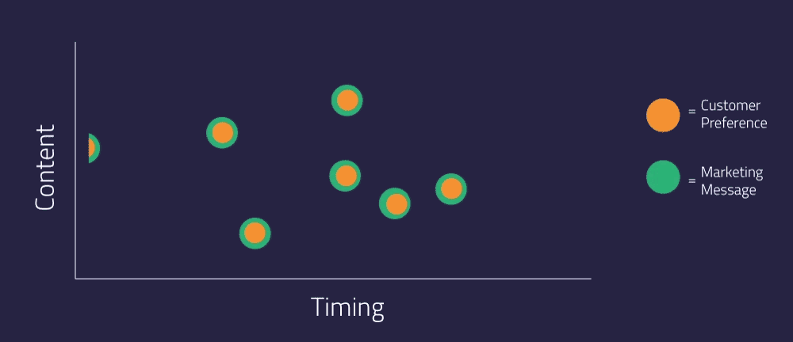

Slide 4

Artificial Neural Network
Artificial neural networks; learns or trains by processing examples, each of which contains a known "input" and "output". creates probability-weighted relationships between the two that are stored in the data structure of the network.
With Artificial Neural networks, the way the simple biological nervous system works is imitated.

Slide 5


Slide 6

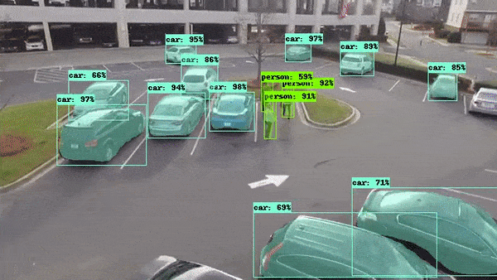
Fields of Computer Vision
Self-Driving
Social Network Filtering
Camera and Filters
Bioinformatics
Advertising
Image Processing
Healthcare
Real-time sport tracking
Agriculture
Education
Many others

Slide 7
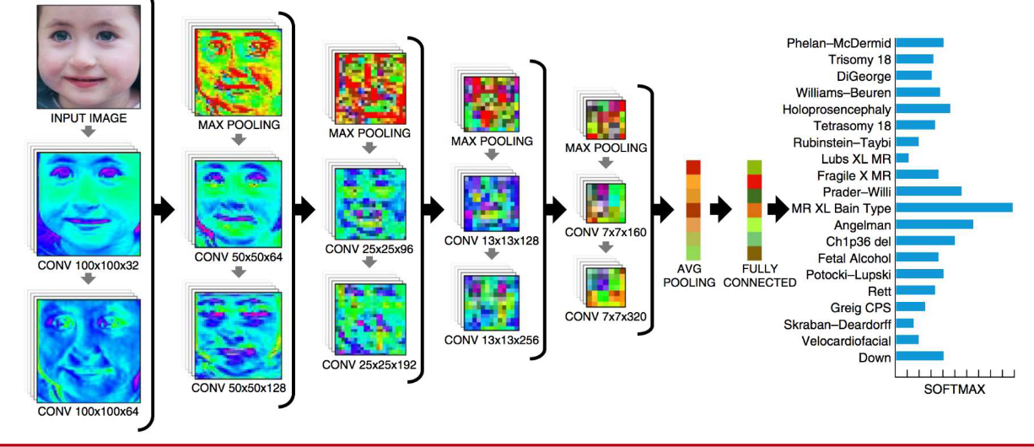
Genetic Disorders Using Deep Learning

Slide 8
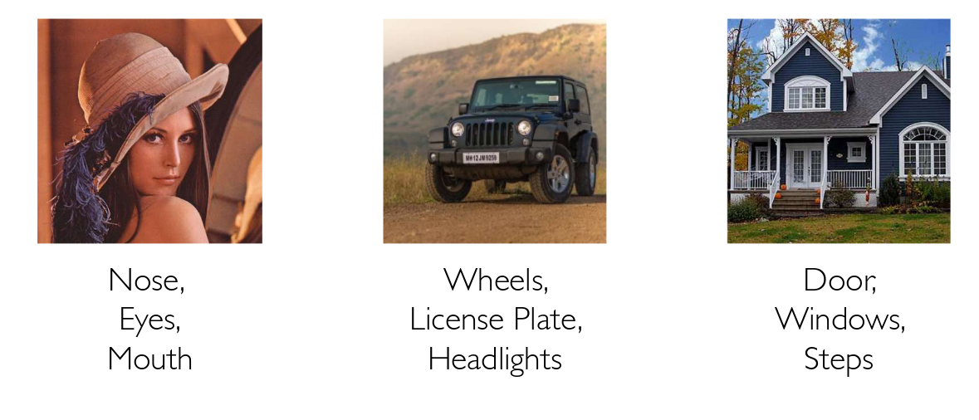
Feature Detection Example
Let’s identify key features in each image category

Slide 9
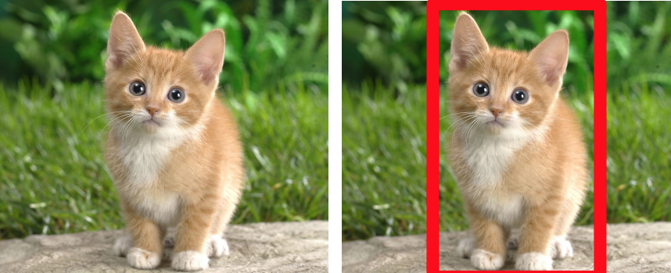
Image Classification & Localization
Image classification is a task where an image is classified into one or multiple classes based on the task.
Input: an image Output: one or multiple class(es)
Image/Object localization is a regression problem where the output is x and y coordinates around the object of interest to draw bounding boxes.

Slide 10
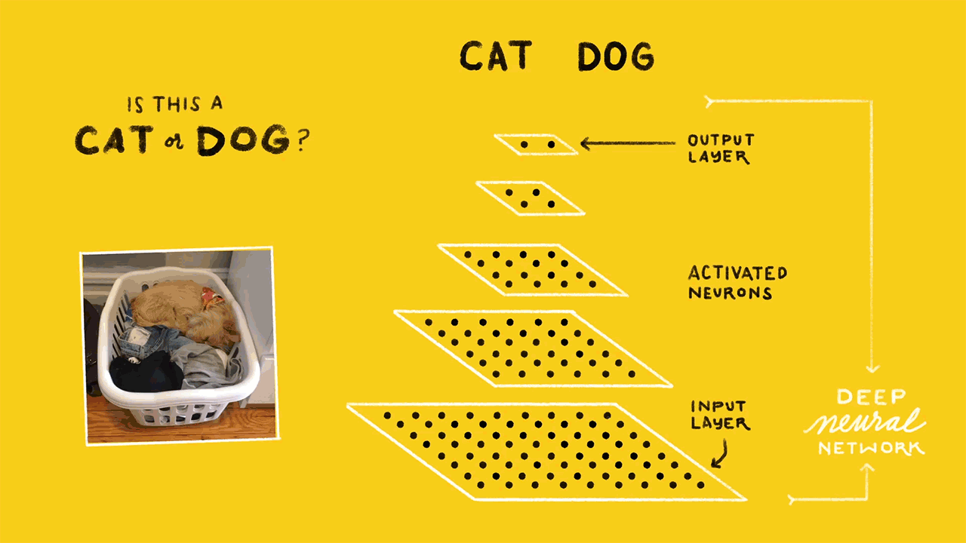

Slide 11
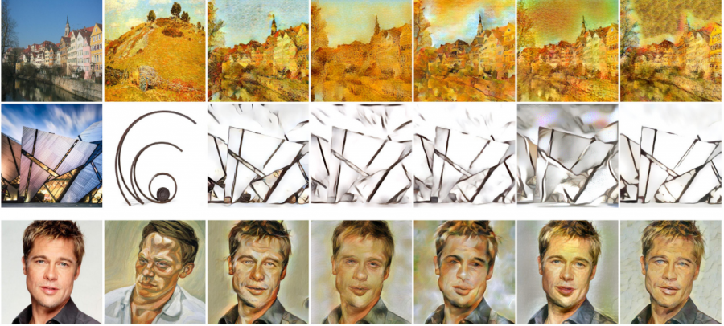
Style Transfer

Slide 12
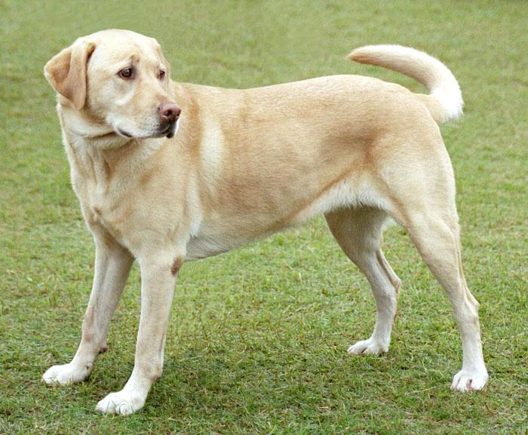
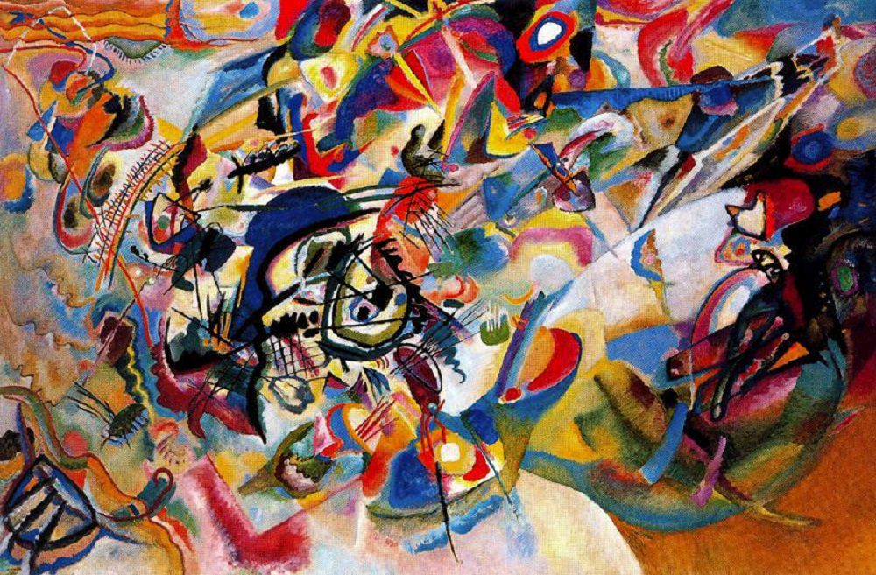
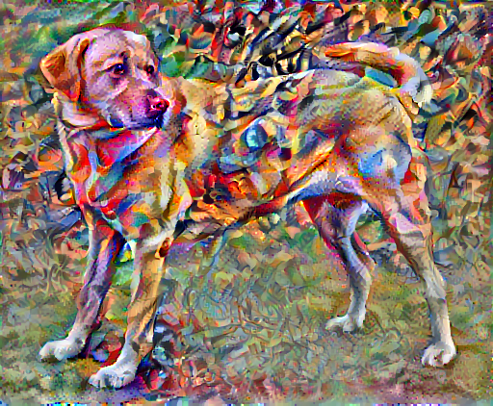
Style Transfer Example
How would it look like if Kandinsky decided to paint the picture of this Dog exclusively with this style?

Slide 13
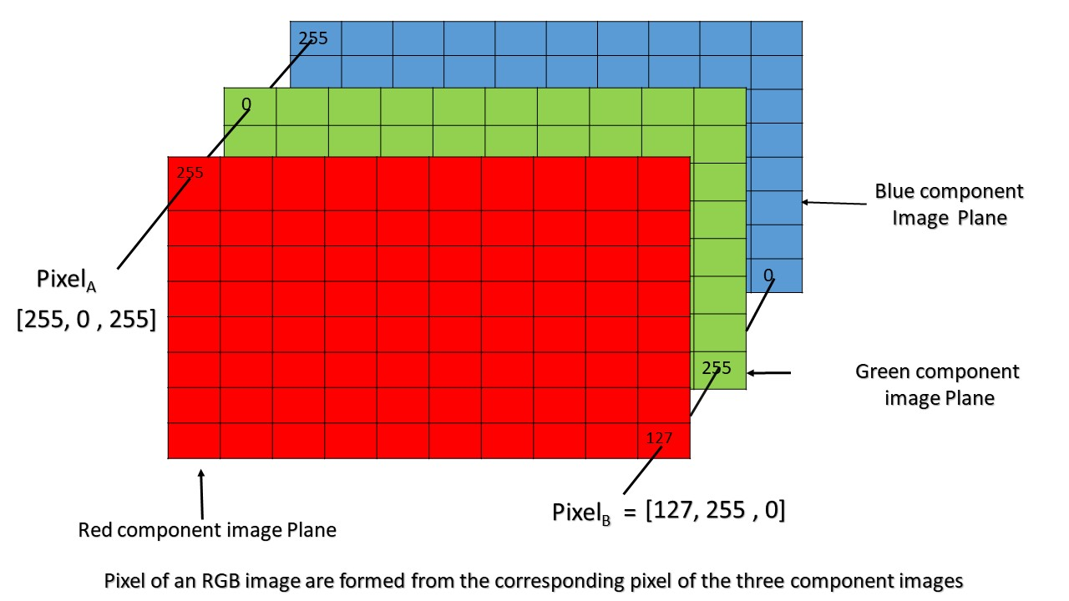
RGB Image Representation
Pixel of an RGB image are formed from the corresponding pixel of the three component images

Slide 14
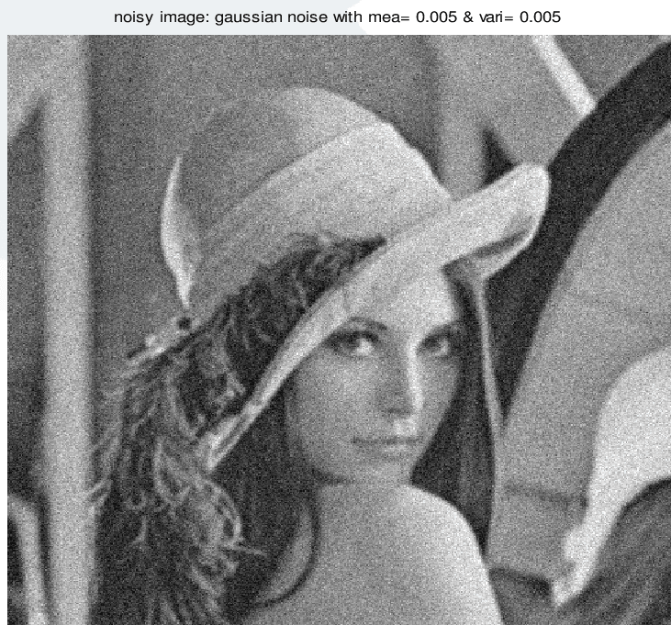
Image Noise
Salt and Pepper Noise
Fixed-Pattern Noise
Gaussian Noise
Shot Noise
Film Grain
Read Noise
Anisotropic Noise
Quantization Noise
Periodic Noise
Branding Noise
Random Noise

Slide 15
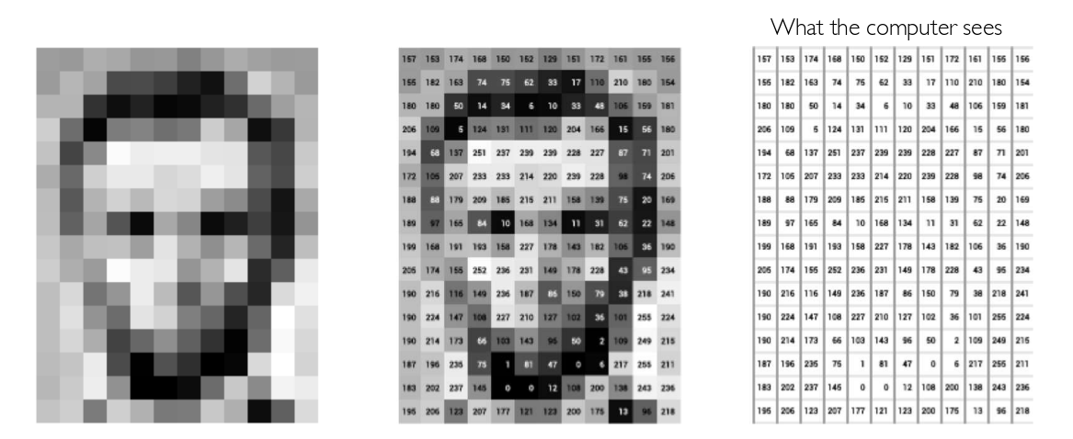
Images are Numbers
An image is just a matrix of numbers [0,255]

Slide 16
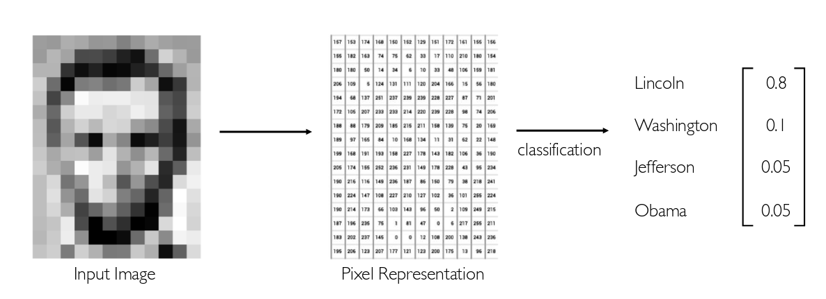
Task in Computer Vision
Pixel representation and classification process
Regression: output variable takes continuous value
Classification: output variable takes class label. Can produce probability of belonging to a particular class

Slide 17
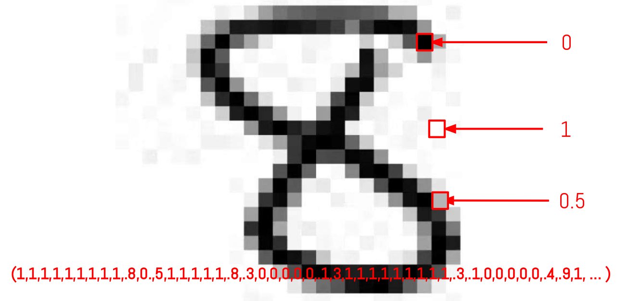
Images as Vectors
Each image consist of pixels and pixels represents vectors

Slide 18
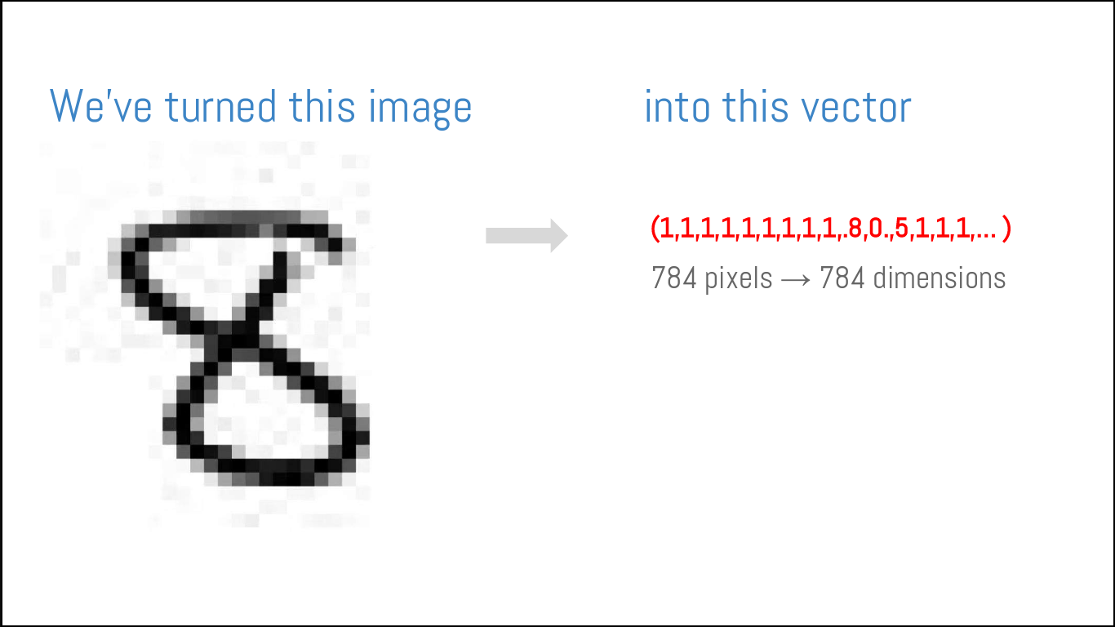
Pixels and Vector
Conversion of pixel values to vector

Slide 19
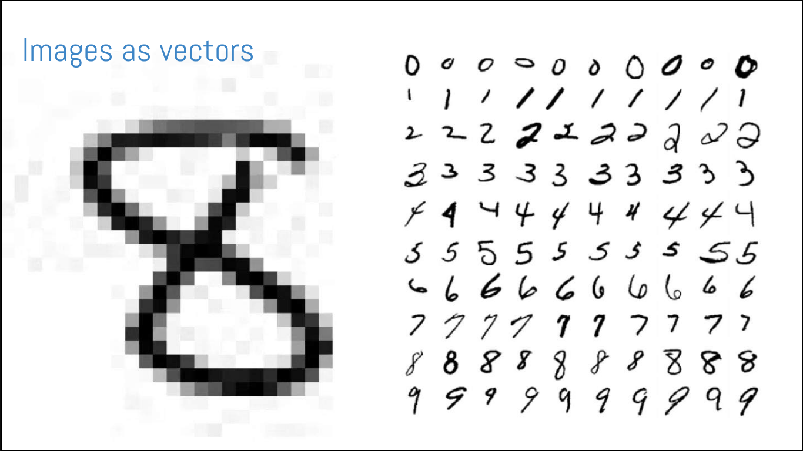
Numbers and Classification Process
Each image contains pixels value and a classification operation is done with many images.

Slide 20
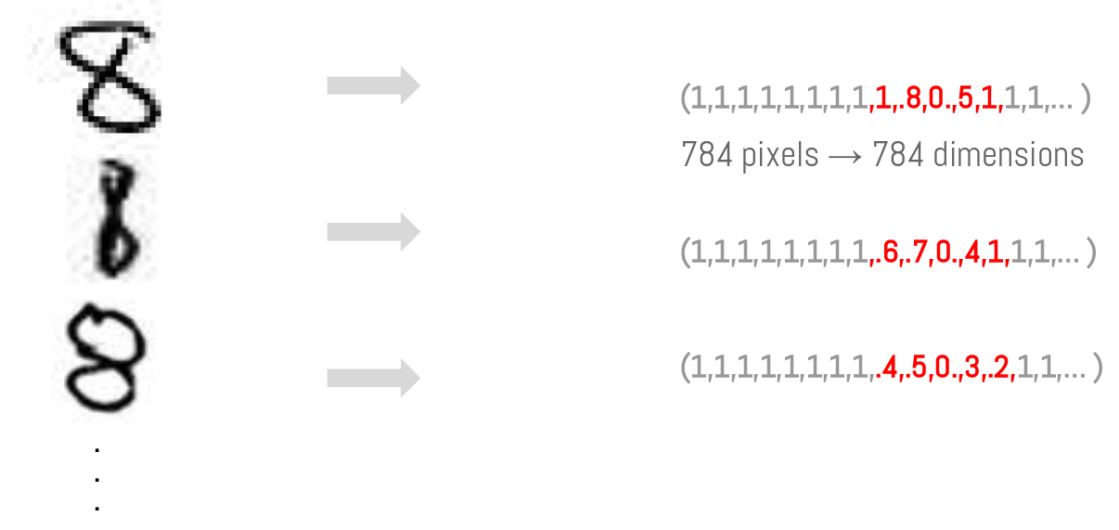
Image to vector
We’ve turned images into vector

Slide 21
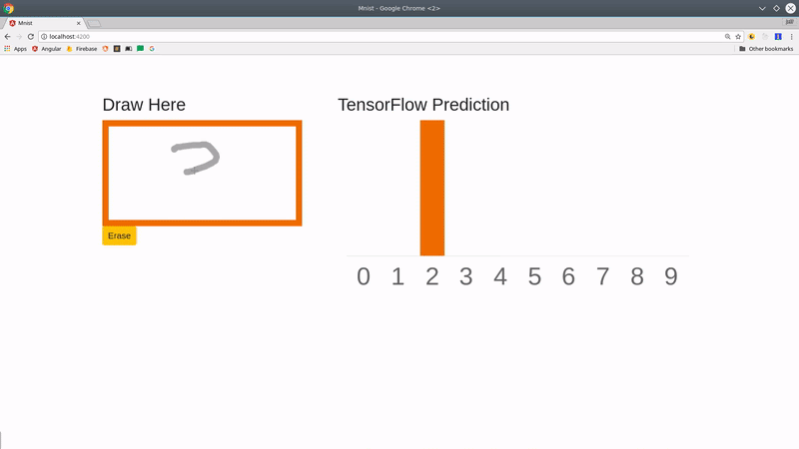
Number and Prediction Game
Game of guess the handwritten number in draw here area

Slide 22
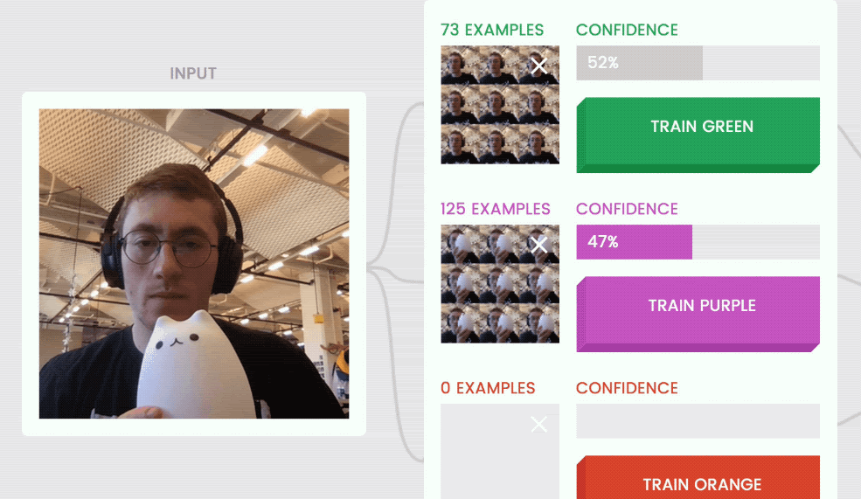
Learning and Prediction
You can find more examples of game in tensorflow.org/js

Slide 23
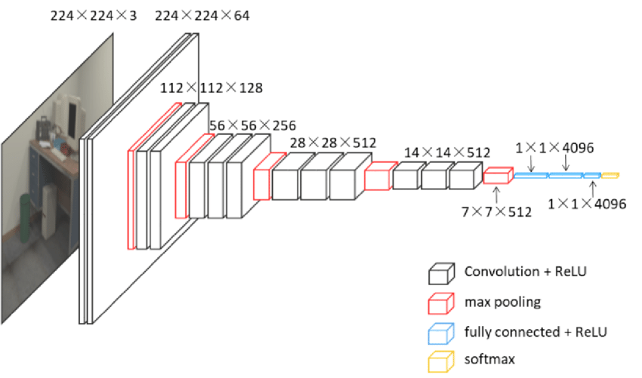
Types of Deep Learning Algorithms
Convolutional Neural Networks (CNNs)
Long Short Term Memory Networks (LSTMs)
Recurrent Neural Networks (RNNs)
Generative Adversarial Networks (GANs)
Radial Basis Function Networks (RBFNs)
Multilayer Perceptrons (MLPs)
Self Organizing Maps (SOMs)
Deep Belief Networks (DBNs)
Restricted Boltzmann Machines( RBMs)

Slide 24

Convolutional Neural Network
Simple Convolutional Neural Network Notation

Slide 25

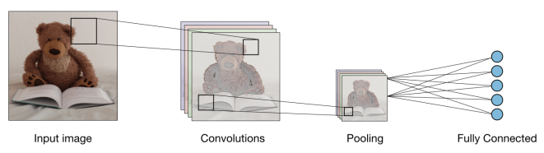
Example of CNN Process
An image goes through various layers and various processes during the Convolutional Neural Network’s training process.

Slide 26
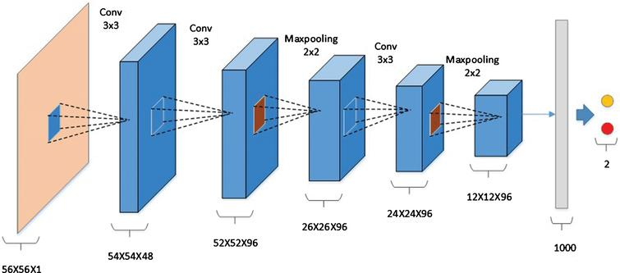
CNN and Layers
CNN contains;
Convolutional Layer
Non-Linearity Layer
Pooling (Downsampling Layer)
Stride
Padding
Flattening Layer
Fully-Connected Layer

Slide 27
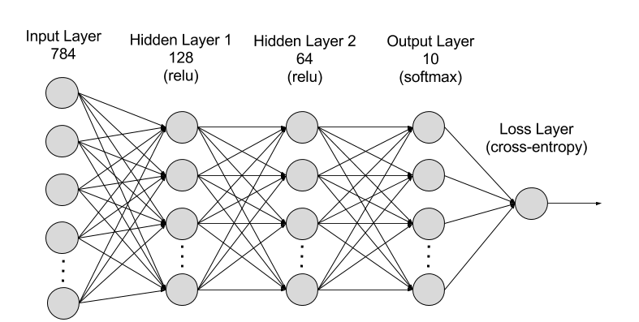
Input Layer
Input layer in CNN should contain image data. Image data is represented by three dimensional matrix as we saw earlier. You need to reshape it into a single column.
Suppose you have image of dimension 28 x 28 =784, you need to convert it into 784 x 1 before feeding into input.
If you have “m” training examples then dimension of input will be (784, m).

Slide 28

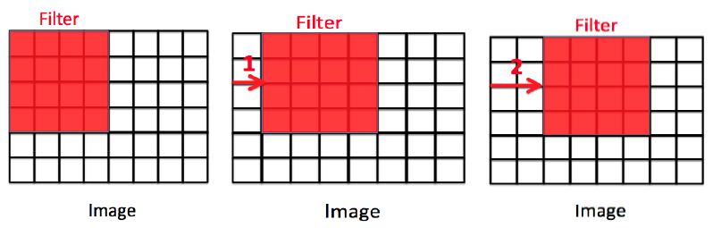
Stride
When computing the cross-correlation, we start with the convolution window at the upper-left corner of the input tensor, and then slide it over all locations both down and to the right.
Sometimes, either for computational efficiency or because we wish to downsample, we move our window more than one element at a time, skipping the intermediate locations.
We refer to the number of rows and columns traversed per slide as the stride.

Slide 29
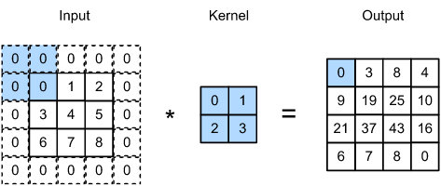
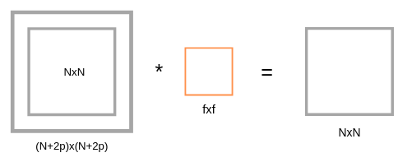
Padding
One tricky issue when applying convolutional layers is that we tend to lose pixels on the perimeter of our image.
Since we typically use small kernels, for any given convolution, we might only lose a few pixels, but this can add up as we apply many successive convolutional layers.
One straightforward solution to this problem is to add extra pixels of filler around the boundary of our input image, thus increasing the effective size of the image.

Slide 30

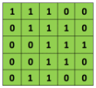
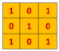
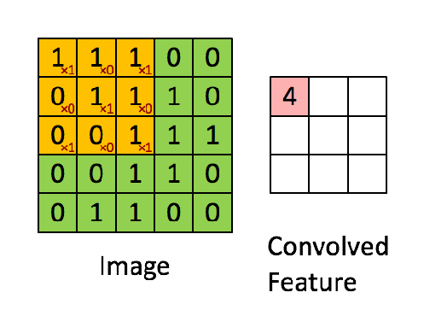
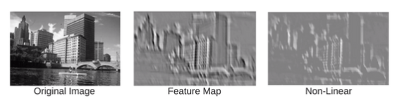
Convolution Layer
A convolution is the simple application of a filter to an input that results in an activation.

Slide 31
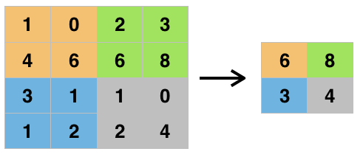
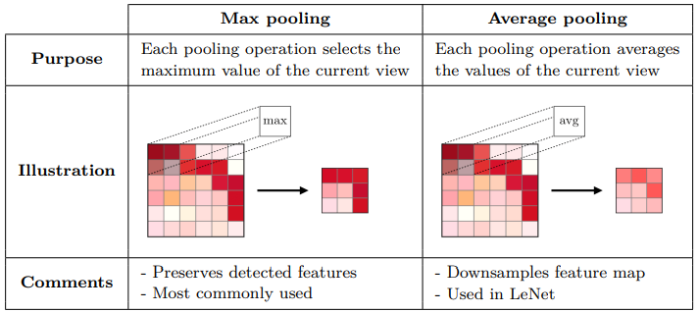
Pooling
A pooling layer is another building block of a CNN.
Its function is to progressively reduce the spatial size of the representation to reduce the number of parameters and computation in the network. The pooling layer operates on each feature map independently.
The most common approach used in pooling is max pooling.

Slide 32
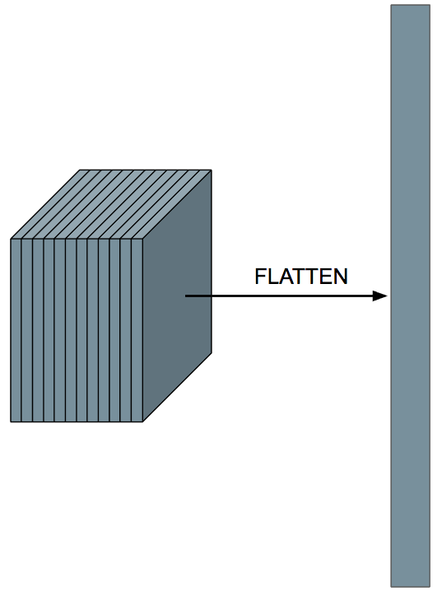
Flattening Layer
Once the pooled featured map is obtained, the next step is to flatten it.
Flattening involves transforming the entire pooled feature map matrix into a single column which is then fed to the neural network for processing.

Slide 33
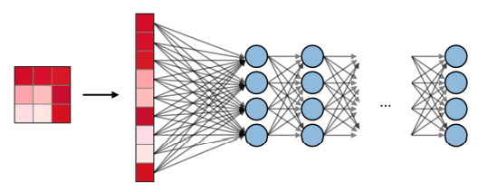
Fully Connected Layer
Fully Connected layers are those layers where all the inputs from one layer are connected to every activation unit of the next layer.
In most popular machine learning models, the last few layers are fully connected layers that compile the data extracted by previous layers to form the final output.

Slide 34
Data Augmentation

Slide 35
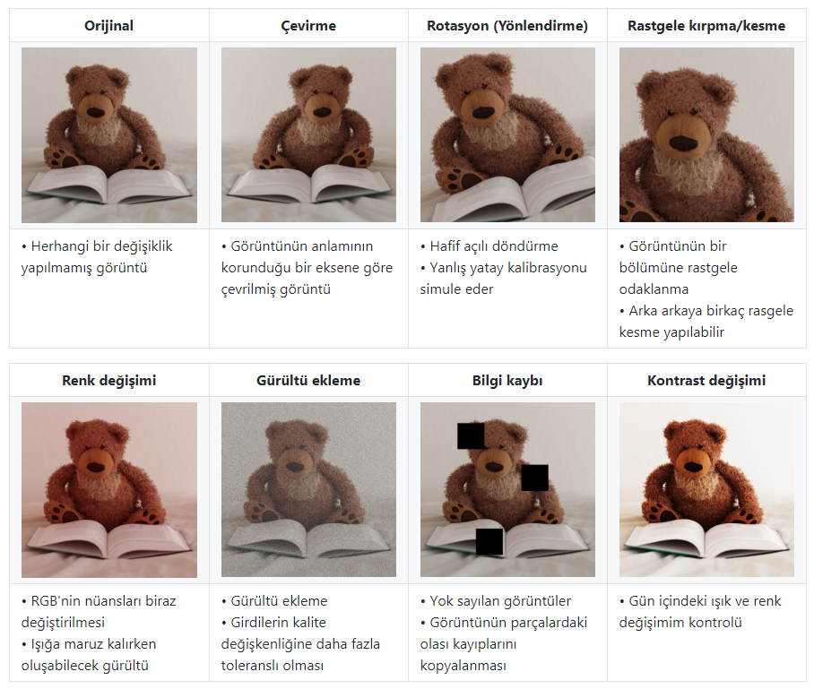
Data Augmentation
Data augmentation in data analysis are a technique used to increase the amount of data by adding slightly modified copies of already existing data or newly created synthetic data from existing data.
It acts as a regularizer and helps reduce overfitting when training a machine learning model.
It is closely related to oversampling in data analysis

Slide 36
Object Detection

Slide 37
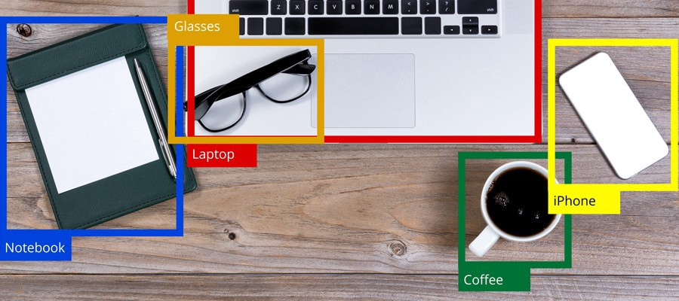
Object Detection
Object detection; locate the presence of objects with a bounding box and types or classes of the located objects in an image.
Input: An image with one or more objects, such as a photograph.
Output: One or more bounding boxes (e.g. defined by a point, width, and height), and a class label for each bounding box.

Slide 38
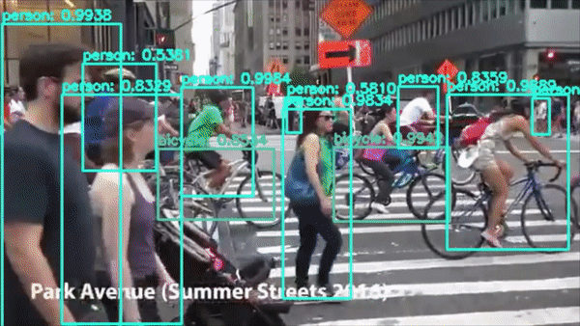
Object Detection and Usage Areas
Advertising: Brand & Logo detection, Human Behavior Analysis
Autonomous Driving: Pedestrian Detection, Traffic Light Detection
Defense & Space Exploration: Remote Sensing Target Detection
Healthcare: Medical Imaging & Diagnostics
Robotics: Robot Vision & Manipulation
Security: Video Surveillance, Traffic Monitoring

Slide 39
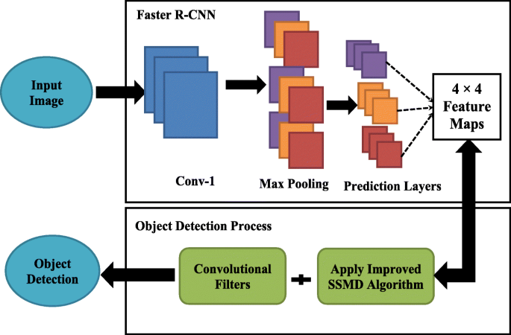
Some Object Detection Methods
R-CNN
Fast R-CNN
Faster R-CNN
YOLO
SSD
RefineNet
RefineDet

Slide 40
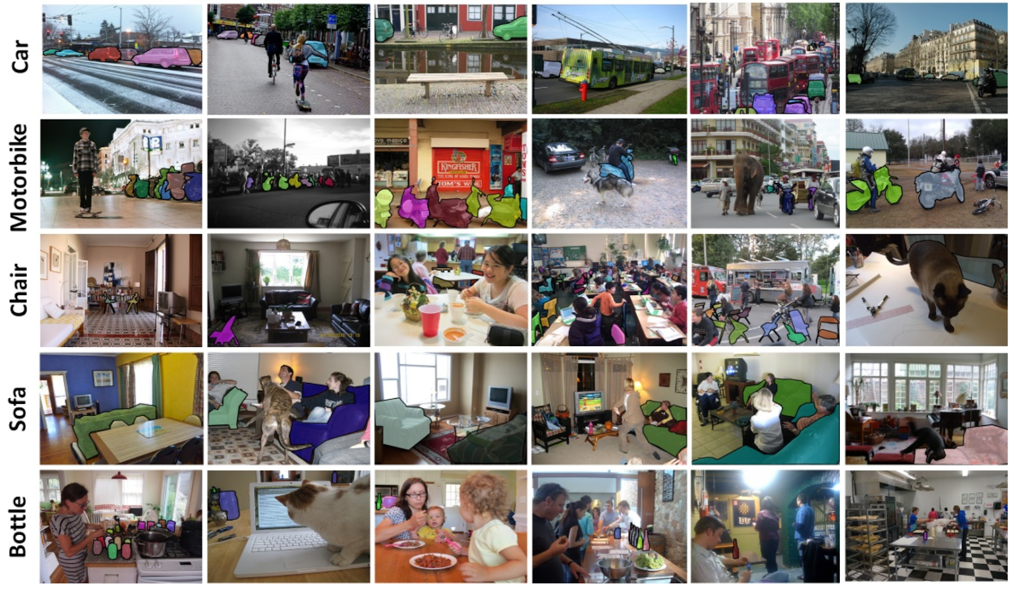
Object Detection Datasets
COCO
Kitti
Pascal VOC()
Wider_Face
AID (Aerial Image Datasets)
DIOR Datasets

Slide 41
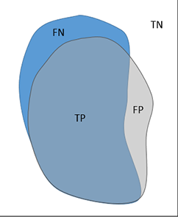
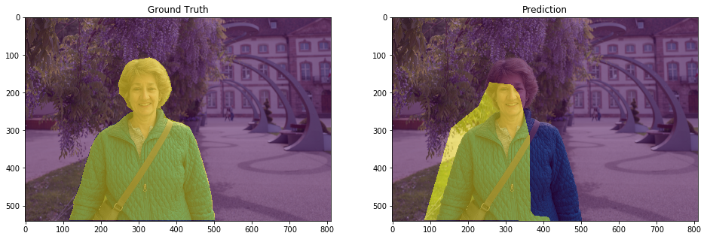
Metrics

Slide 42

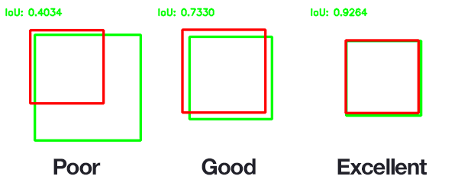
IoU Score Example
Intersection over Union is an evaluation metric used to measure the accuracy of an object detector on a particular dataset.
A score of 1 means that the predicted bounding box precisely matches the ground truth bounding box.
A score of 0 means that the predicted and true bounding box do not overlap at all.

Slide 43
Thanks!
Does anyone have any questions?
iremkomurcu.com
irem.komurcu@globalaihub.com

